Slide 1

UX Design and Implementation PawPal
Presented by:
Aishwarya Chandradhara
Akshay Kumar Tadapathri
Gautam Rattihalli
Nithin Bhardwaj
Shivani Deepak Moray

Slide 2
TABLE OF CONTENTS
01
05
02
06
INTRODUCTION
USABILITY TESTING
TECHNOLOGIES USED
MOTIVATION
03
CHALLENGES
07
PROPOSED DESIGN
PRINCIPLES OF UI
04
DEMO
08

Slide 3
INTRODUCTION
Design and Implementation of an Application to provide a platform for users to showcase their pets for adoption and for interested users to contact the owners.

Slide 4
MOTIVATION
01
02
03
To provide a platform for users to showcase their pets for adoption.
To provide an interactive pet adoption website for pet lovers.
To provide a user friendly, innovative and functional website.

Slide 5
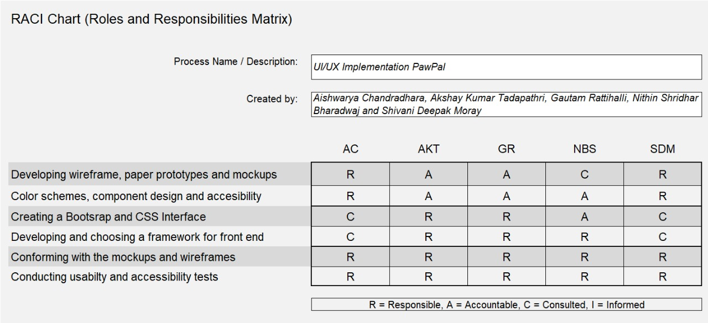
TASK DISTRIBUTION

Slide 6
SITE MAP
Landing Page
Choose Pet
Services
New Comers
Footer
Dog or Cat
Contact Us
Pet Basics
Pet Details
Contact Owner

Slide 7
PROPOSED DESIGN
01
02
03
PAPER PROTOTYPE
WIREFRAME
MOCKUP
A process that helps developers to create software that meets the user's expectations and needs.
A visual guide that represents the skeletal framework of a website.
A full-size model of a design , used for demonstration, design and evaluation, promotion.

Slide 8
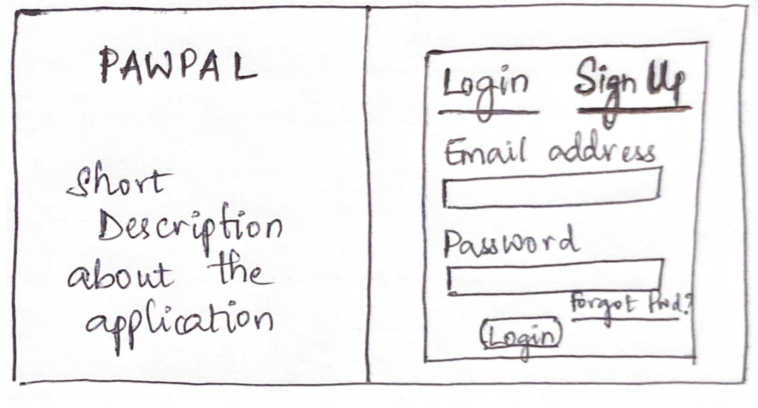
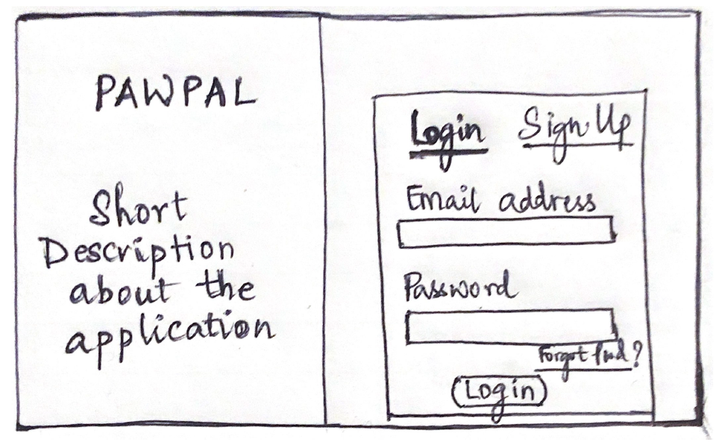
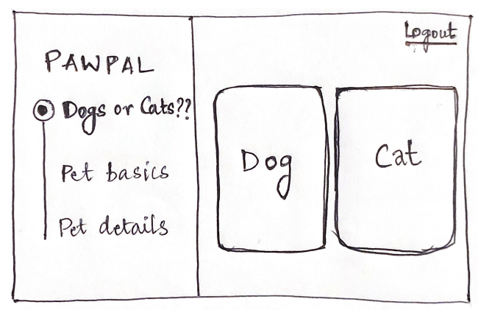
PAPER PROTOTYPE

Slide 9
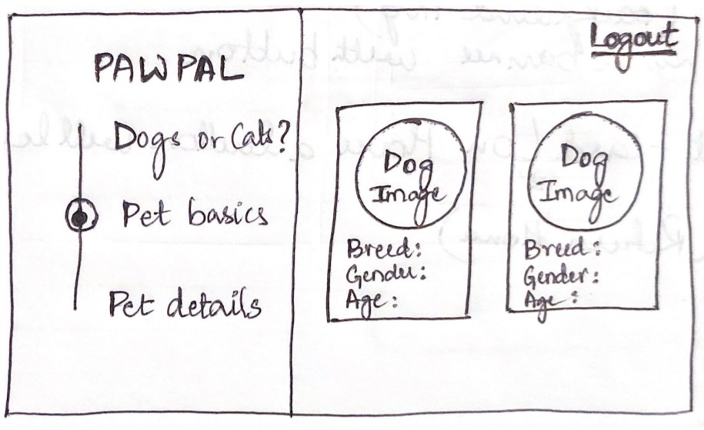
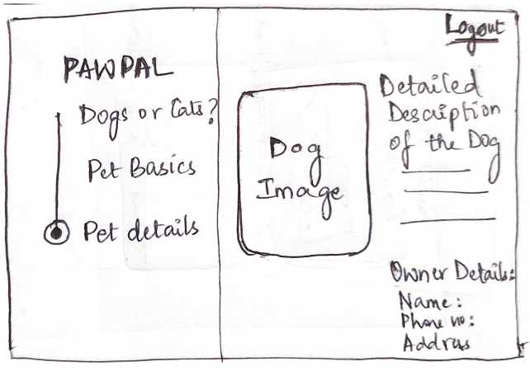
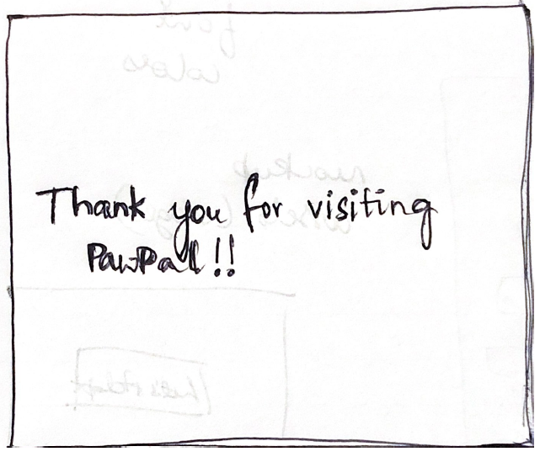
PAPER PROTOTYPE

Slide 10
WIREFRAME & MOCKUP
https://xd.adobe.com/view/5da2627f-6800-4dcc-614c-1e4b1e1cbd4a-2b93/
https://xd.adobe.com/view/a32c540f-169b-4e46-6647-c647ec4c1429-d51d/
Wireframe
Mockup

Slide 11
USABILITY TESTING
FLOW
VALIDATION
OPINIONS
UX
To validate a Prototype.
To find issues with Complex Flows.
To gather unbiased user opinions.
To get the insights that help create a better overall user experience
Notes:
Usability testing is about getting the real users to interact with the website or the application built to observe the behavior and reactions of the user.
There are various testing methods like moderated, un-moderated, remote and in-person. The testing method which we have used is moderated testing with in-person and remote.
Now lets see the reasons for usability testing:
Validation of a prototype: This is done to pinpoint the critical features of interactions. This is done by creating as many ideas as possible and testing them with the real users.
To find issues with complex flows: To understand this and to find the complexity in the user flow diagram.
user flow is a series of steps starting from the entry point towards a successful outcome and final action.
To gather unbiased user opinions: Not all the users have the same opinion on the application built. Gathering different opinions from the different users is important.
To get insights: All the opinions and insights gathered from the users helps the designers to create a better user experience.

Slide 12
EVALUATION OF TASKS
01
02
03
Navigate to the page to select the type of pet you like to adopt.
Find the list of pets which are up for adoption.
Filter the pets with respect to its gender and age.
04
05
06
Navigate to the page to find the detailed description of a pet.
Navigate to and contact the Owner of the pet you would like to adopt.
Navigate to and contact the Company to put your pet up for adoption.
07
08
09
Find the recently added pets to the collection.
Navigate to the previous page from the Pet details page.
Accessibility to the entire landing page.
Notes:
These are the 9 task scenarios for the usability testing:
Among which I will explain 2 of the scenarios.
Task2, Task4

Slide 13
PARTICIPANT PROFILE
Participant | Age | Gender | Profession
Sanchitha | 22 | Female | Civil Engineer
Sandesh | 26 | Male | Software Engineer
Ashwin | 18 | Male | Student
Schall Elmar | 56 | Male | Product Owner
Reena | 35 | Female | Architect
Notes:
Selection of users for the usability testing was done based on the age, ethnicity and profession. So these are the 5 users which we choose for our testing.

Slide 14
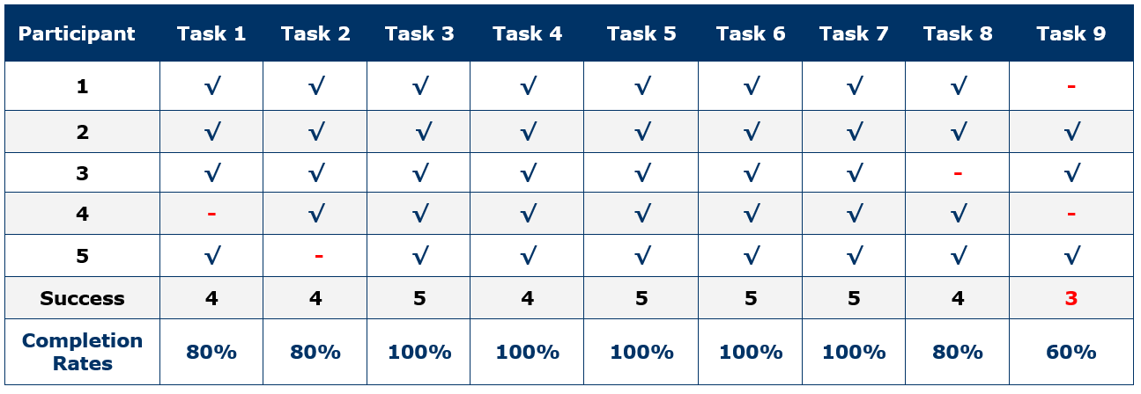
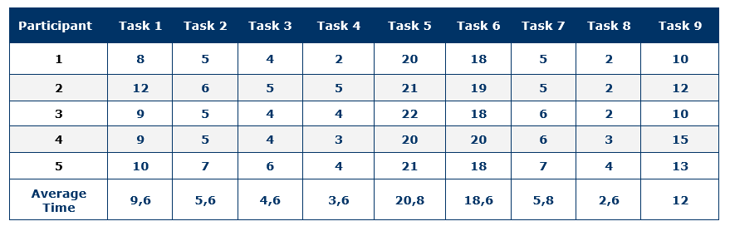
RESULTS
Task Completion Rates
Time on Task
Notes:
We have two results here, based on the performance rate and based on the time spent on each task.

Slide 15
PRINCIPLES OF UI USED
FOCUS
05
COLOR CONTRAST
04
03
NAVIGATION
02
01
ALTERNATIVE TEXT
LABELS & INSTRUCTIONS
Notes:
Adequate color contrast is a primary component of accessibility.
In the application, we have used pleasant set of colors soothing to the eyes.
Having the user focused on the major task of the application is good UI/UX.
Also, the focus of each of the page the user navigate should be well understood to the user.
These should be as intuitive as possible and self explanatory.
ease in understanding the labels and zero complexity with instructions.
When dealing with images in the app having proper alt text is useful.
Navigation is the key to a good application.
navigation should be well defined throughout the task until the user achieves the final task.

Slide 16
CHALLENGES
UI Challenges
01
03
02
Bridging the Gap between development and design.
Educating the users as to how important is User experience is and why it's necessary.
Adapting designs to ever changing business requirements.

Slide 17
CHALLENGES
01
03
02
Technical Challenges
Adapting to a new framework and architecture
Implementation of complex UI components e.g. side navigation bar
Creating a content management system and accessing it to host the website.

Slide 18



Technologies used:
React 16
React Context
Styled components
Material UI
CMS using Contentful
Hosting using Netlify

Slide 19
DEMO
https://pawpal.netlify.com/

Slide 20
THANK YOU!
https://github.com/akshaykumar771/PawPal_UIUX

